Slide 1
PDF Assistant
Using RAG pipeline with Terraform Deployment and Nagios Monitoring.

Slide 2
Stages
The Project consist of 2 main stages:
1) Building
2) Deployment
The Building consist of Backend logic, Streamlit application and containerization using Docker.
The Deployment stage consist of Provisioning resources uses Terraform and Monitoring using Nagios.

Slide 3
Build Stage

Slide 4

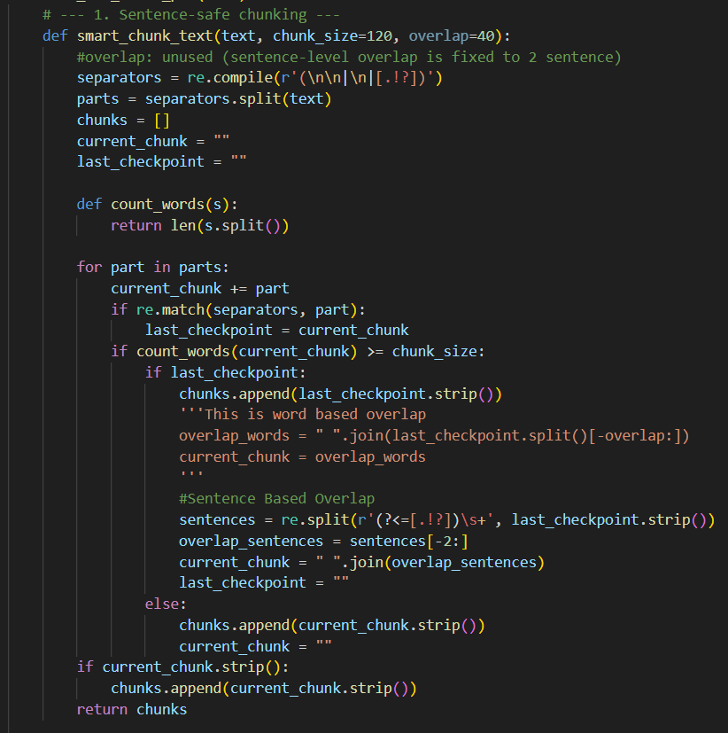
Backend Logic
1. Loading and smart chunking
Loading through Pymupdf and used a custom sentence level overlap chunking for:
    Semantic Integrity
    Embedding Quality
    Retrieval Performance
    Efficient Q&A
Previously used simple character chunking and Lang Chain’s Recursive text splitter which were not this good in retrieval performance.
Also added meta data like page number for future references.

Slide 5
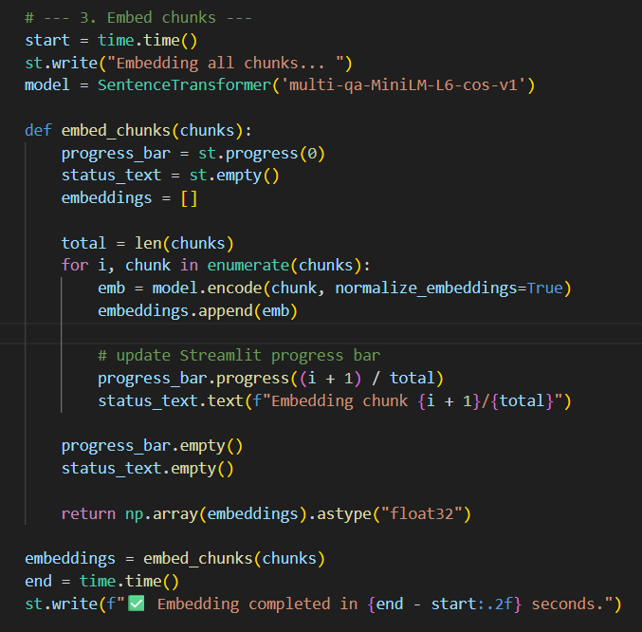
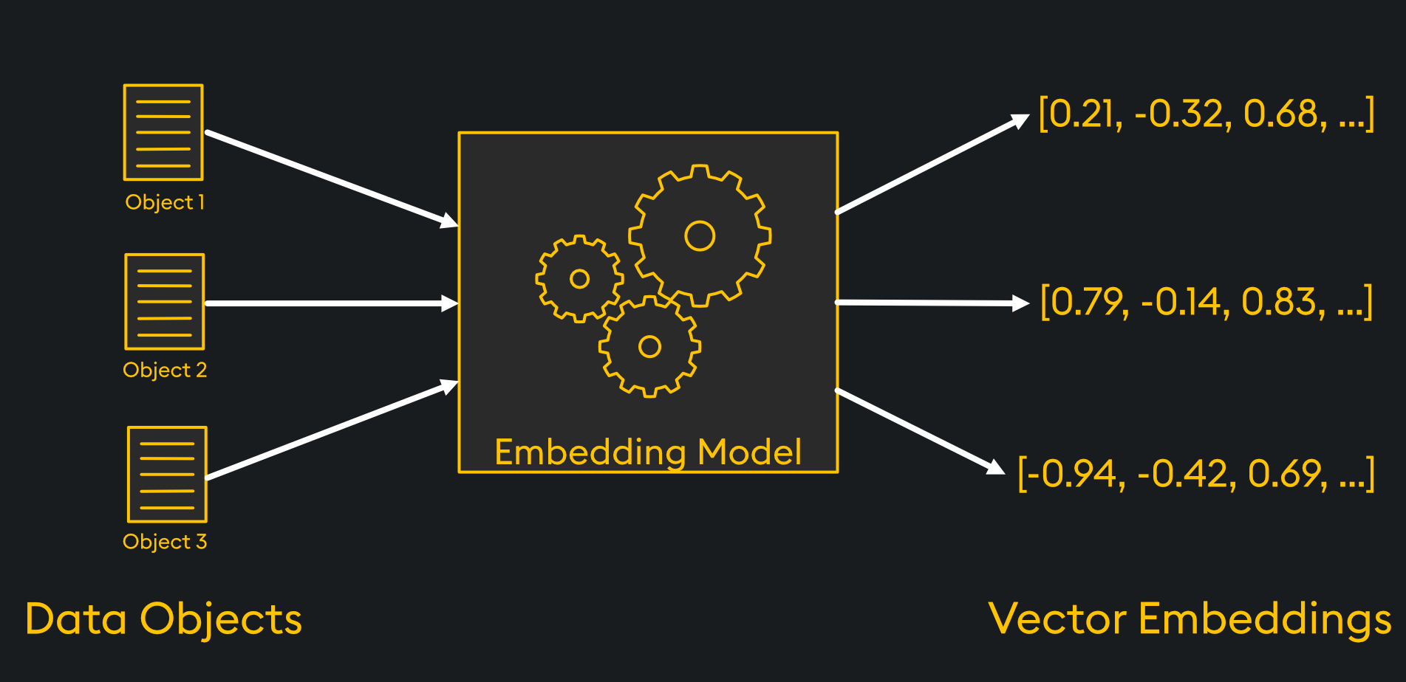
2. Embedding Generation
Generated embeddings using Sentence Transformer for better semantic retrieval.
Additionally, added progress bar and total time for user experience and debugging.

Slide 6
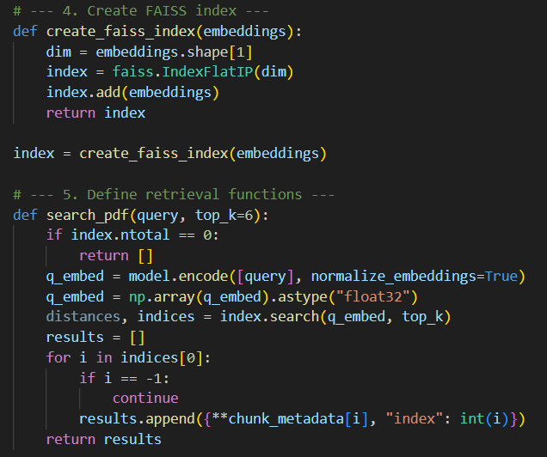
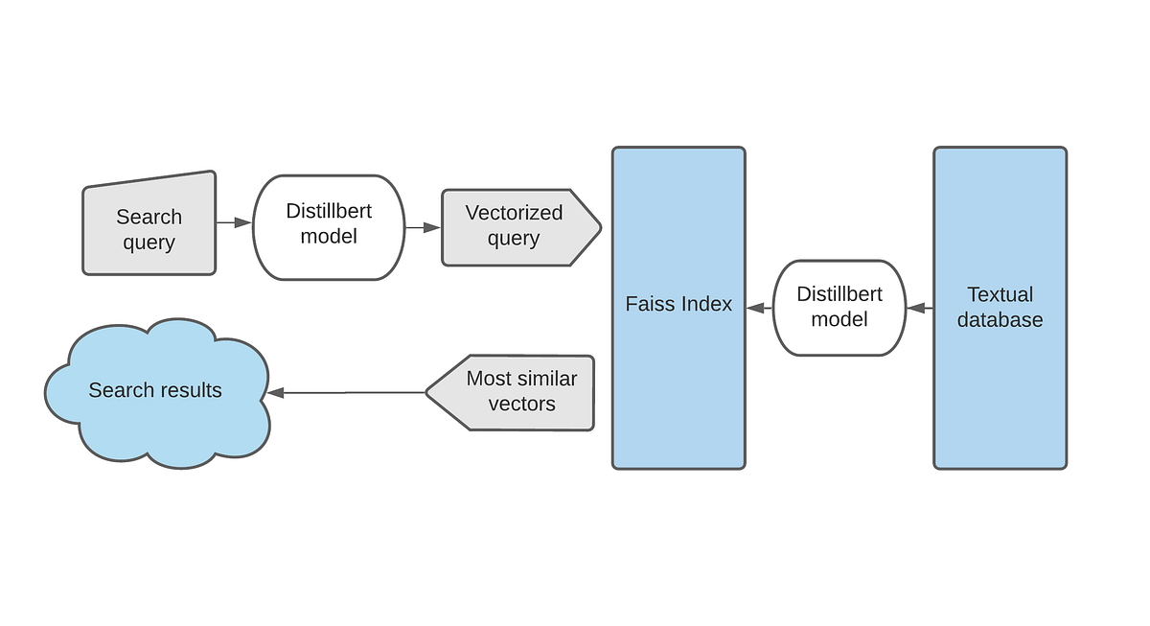
3. Searching
For Semantic similarity used FAISS indexing to search accurately and quickly.
Used faiss.IndexFlatIP instead of FlatL2. As IP acts as cosine similarity which is better in transformers then the normal Euclidean distance.

Slide 7
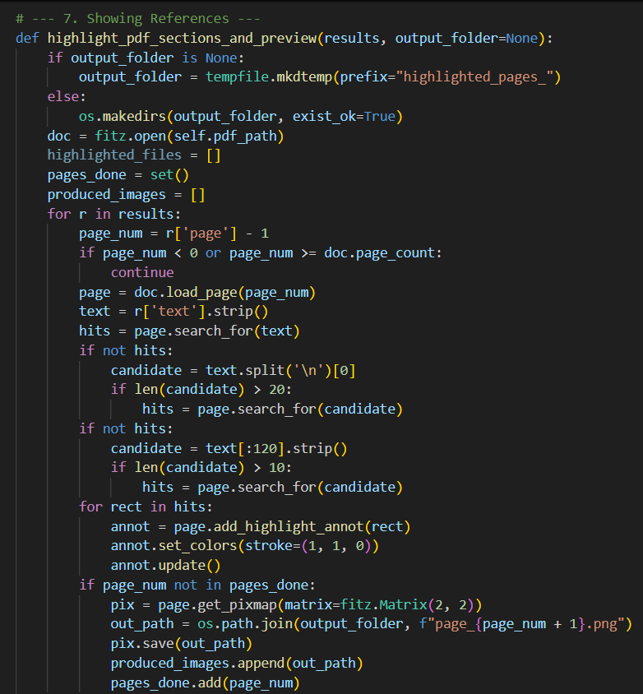
4. Show References
Produced pdf pages with yellow highlights from where the answer is being generated for citations.

Slide 8
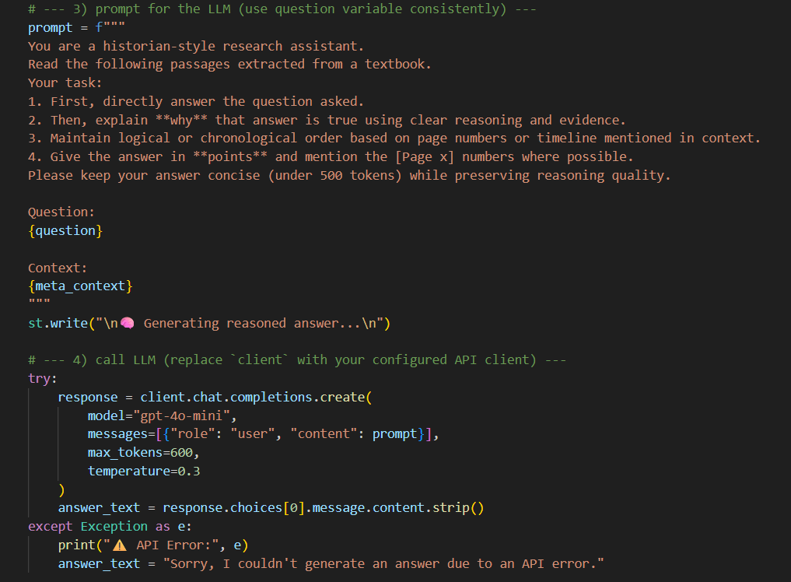
5. Output
Generated the output using gpt-4o-mini model from top 6 retrieved chunks in complete sentences.
Used a GPT model because:
1) Bert is good at understanding and retrieval but not designed to combine information across multiple sections or timelines.
2) T5 handles summarization well but often omits finer details.
3) GPT being generative, produces natural, human-like responses that integrate insights from different parts of the document.

Slide 9
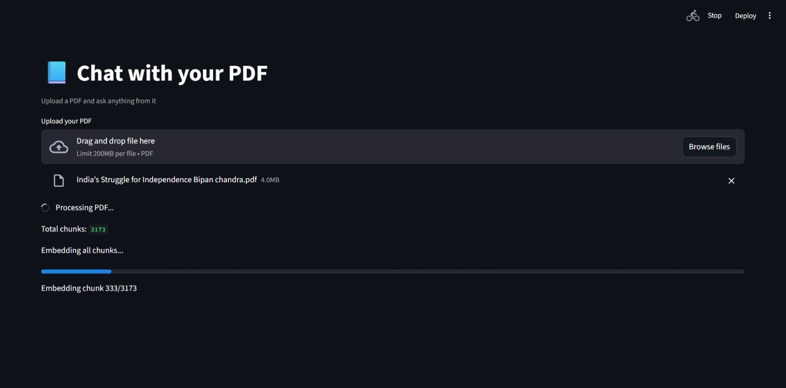
Streamlit App
Used a basic Streamlit application as user interface for the model.
Embedding Generation progress bar and total chunks produced

Slide 10
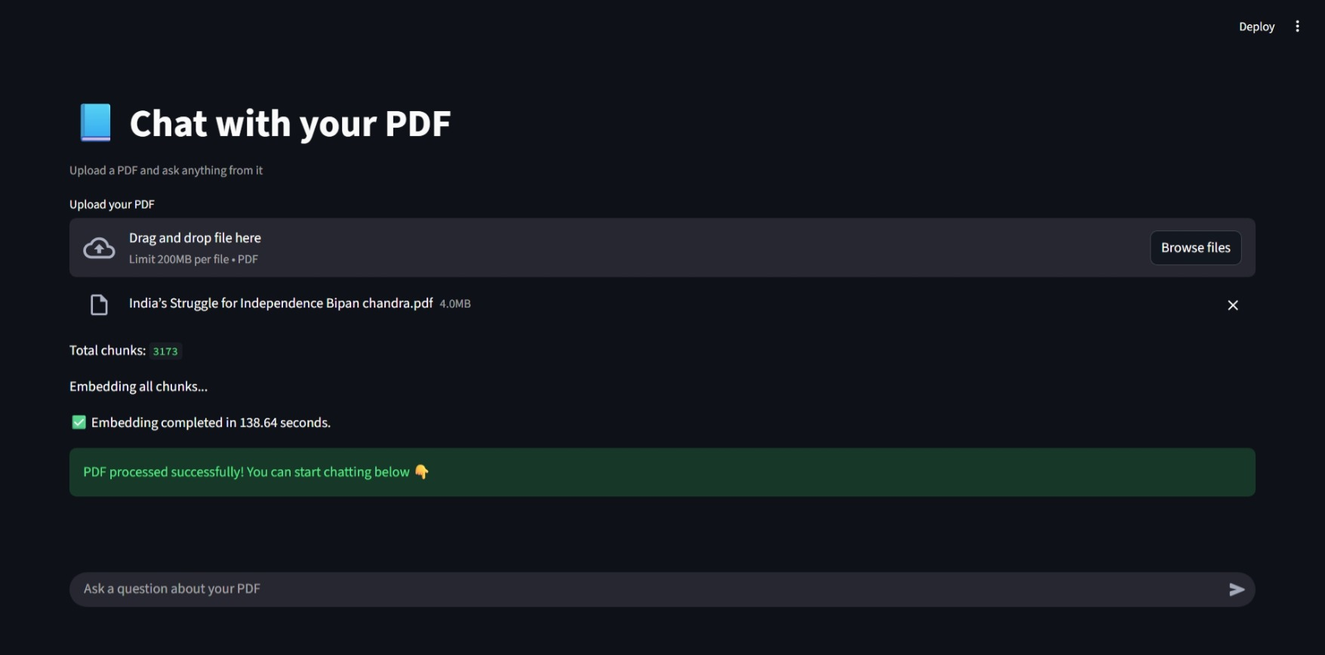
Total time in embedding and start of Q&A

Slide 11
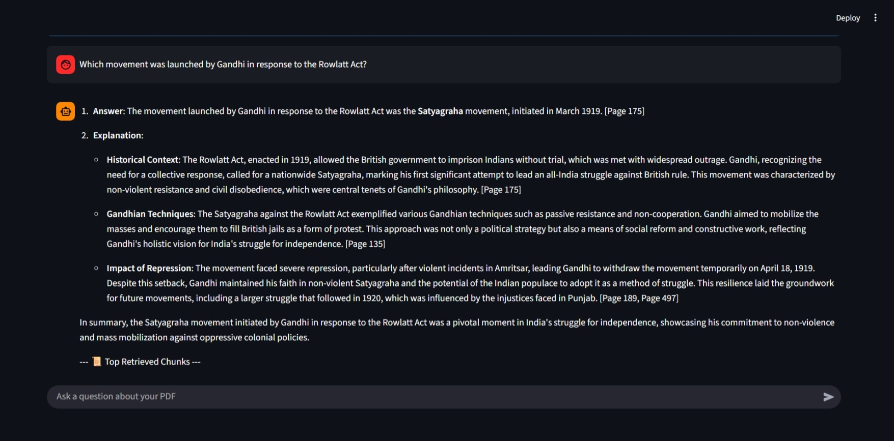
Main Output

Slide 12
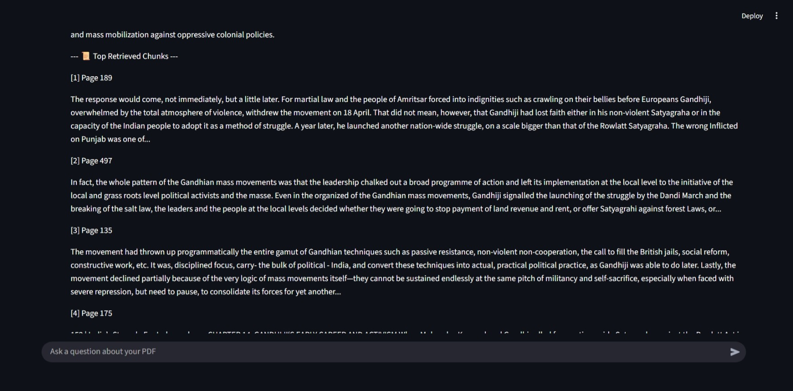
Top Chunks from where the answer is taken

Slide 13
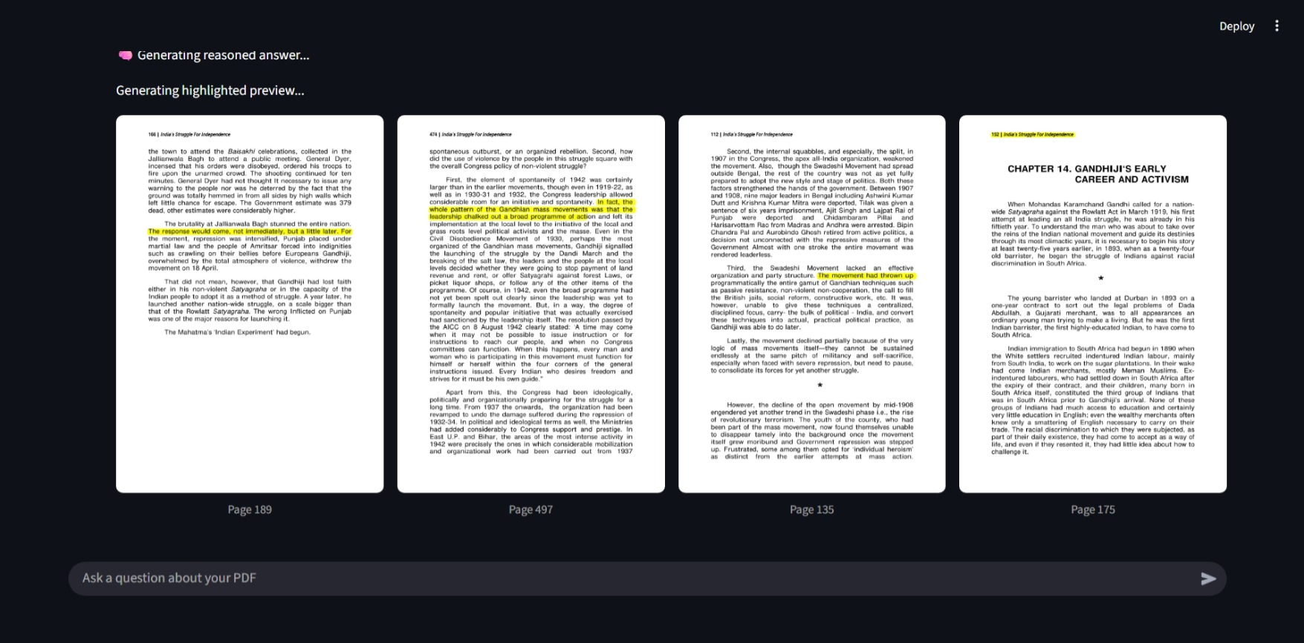
PDF Pages for References

Slide 14
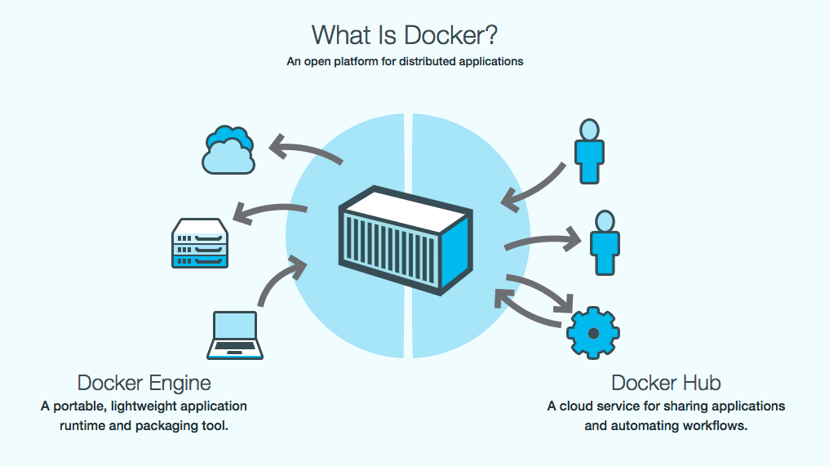
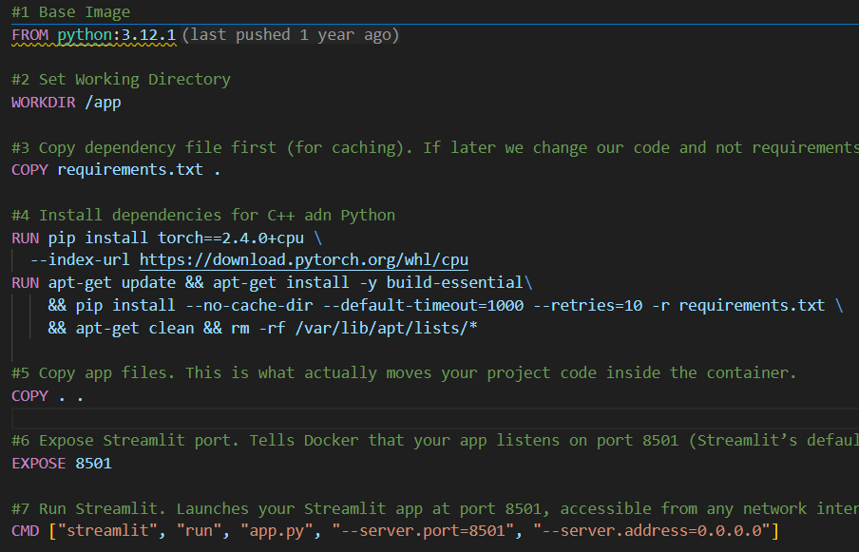
Containerization
Used Docker to build CPU only model image, as GPU one was taking 9GB of storage which would have affected cloud costing.
Expose the image to Streamlit default port of 8501.
Increased default timeout for building image as image is still large.
Used Python 3.12 for proper compatibility with sentence transformer, scikit learn and faiss.

Slide 15
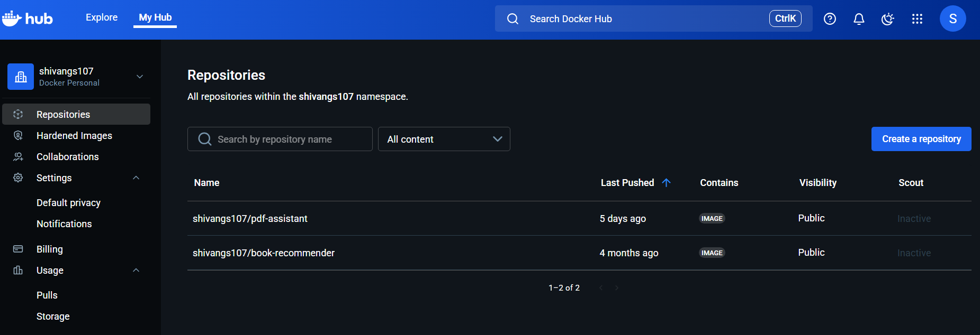
Also uploaded the image on Docker Hub for smooth cloud connectivity

Slide 16
Deployment Stage

Slide 17
Basic Configurations
1) Need to have an account on AWS.
2) Create an IAM user with necessary permissions and generate access key (AdministratorAccess here).
3) Download AWS CLI.
4) On CMD run: aws configure (For connection with your AWS Account)
5) Check if any default vpc present: aws ec2 describe-vpcs --region ap-south-1
else run on CMD: aws ec2 create-default-vpc
6) Put Open API key on CMD:
aws ssm put-parameter --name "OPENAI_API_KEY" --value “real_key" --type SecureString
7) Assign an EC2_SSM_Access role to your IAM with EC2 and SSM read only policy.
8) Install Terraform locally.
9) Make sure docker image is publicly accessible.

Slide 18
Terraform
Created:
1) main.tf -> provider and region selection
2) keypair.tf -> key-pair login for SSH
3) variables.tf -> declare input variables (which can change)
4) ec2.tf -> launches ec2 instance, installs awscli and docker, retrieves api key from ssm and runs docker container on port 8501.
Also sets security group allowing ssh (22 port) and streamlit app (8501 port) access.
5) output.tf -> show ec2 public ip, ssh command for debugging and streamlit app url.

Slide 19
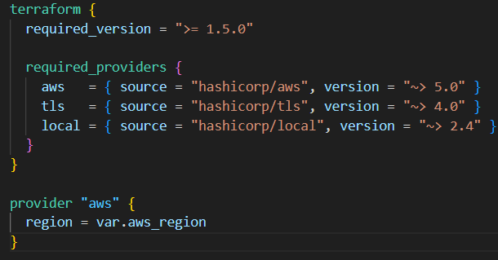
1. main.tf
Makes sure terraform is 1.5 or newer
Declares the plugins like aws, tls (built-in crypto provider) and local
Configure AWS provider with a variable defined on variables.tf to not make it fixed.
Didn’t provide credentials here for security.

Slide 20
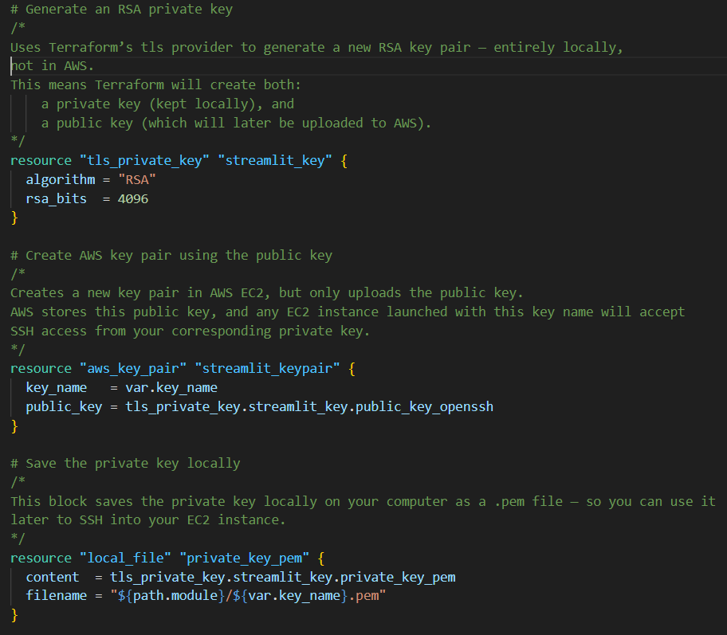
2. keypair.tf
Generates a new RSA key locally using Terraform.
Registers the public key in AWS as a key pair (so EC2 knows it).
Stores the private key securely on your local system (so you can connect later via SSH).

Slide 21
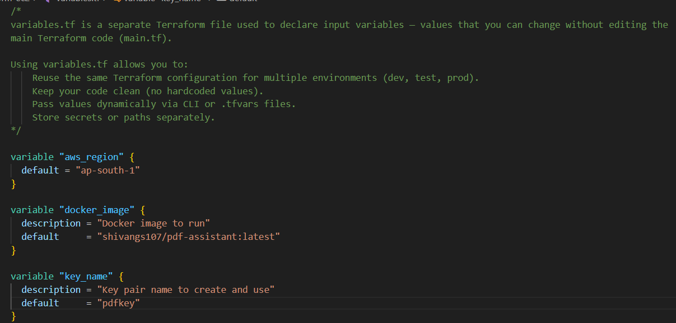
3. variables.tf
It makes out setup configurable and reusable without editing every .tf file
It can use different regions, docker image and key-pairs.

Slide 22
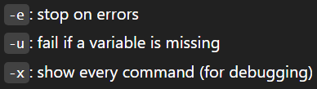
4. ec2.tf
It is the core infrastructure logic of terraform setup. It:
1) Fetches the default VPC in your aws account.
2) Allows your EC2 to fetch secrets like API_Key without hardcoding them.
3) Launches an Ubuntu EC2 instance using AMI.
4) Links to key-pair we created earlier.
5) Assign security groups (inbound/outbound access) and IAM permissions (SSM).
It also runs a bash file which:
1) Redirects output to a log file with eux flags.
2) Install dependencies, AWS CLI and Docker.
3) Retrieve API Key.
4) Run Docker container.

Slide 23
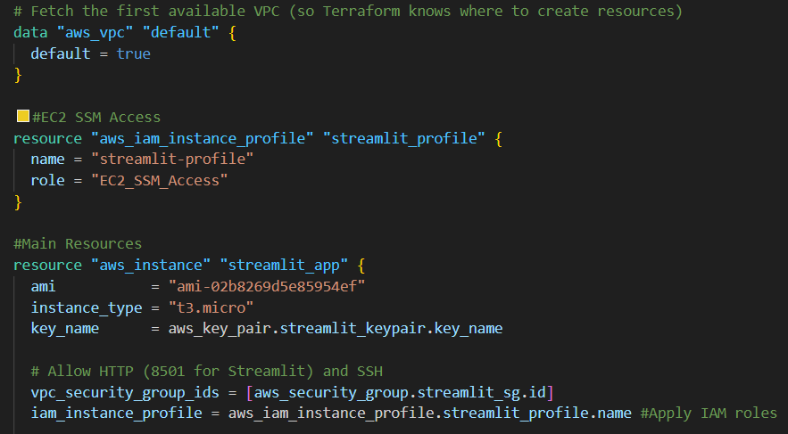
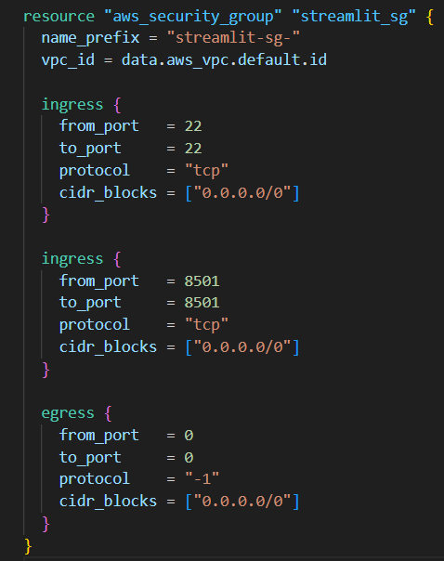
Inbound – 22 and 8501
Outbound – to anywhere
VPC, IAM role and instance creation

Slide 24
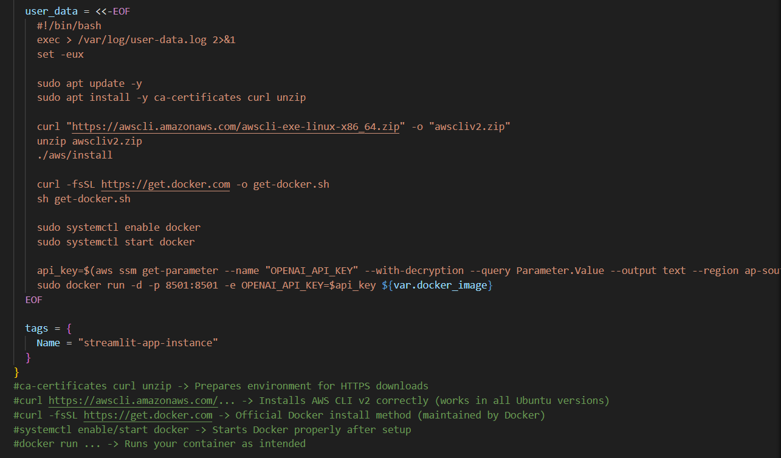
Bash script

Slide 25
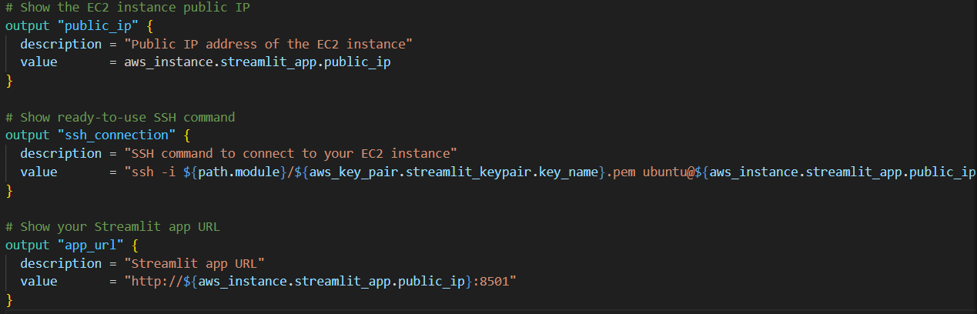
5. outputs.tf
Make sure to change pem file permission to read only before debugging.
It will show:
EC2 instance public IP, ready-to-use SSH command for debugging and Streamlit app URL

Slide 26
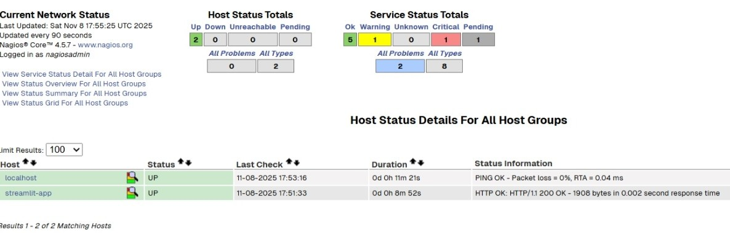
Nagios
1. Built a fully automated, self-healing monitoring pipeline using Terraform, AWS and Dockerised Nagios.
2. Terraform deploys Streamlit app EC2.
Terraform waits until the Streamlit app is actually live.
Then Terraform automatically creates another EC2 (Nagios server).
The EC2_nagios builds, configures, and runs a Nagios container that continuously
checks the Streamlit app’s health.

Slide 27
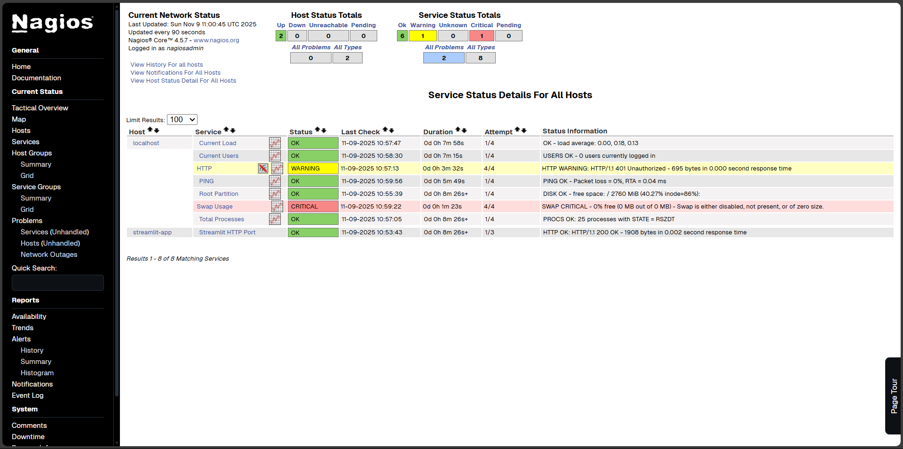

Slide 28
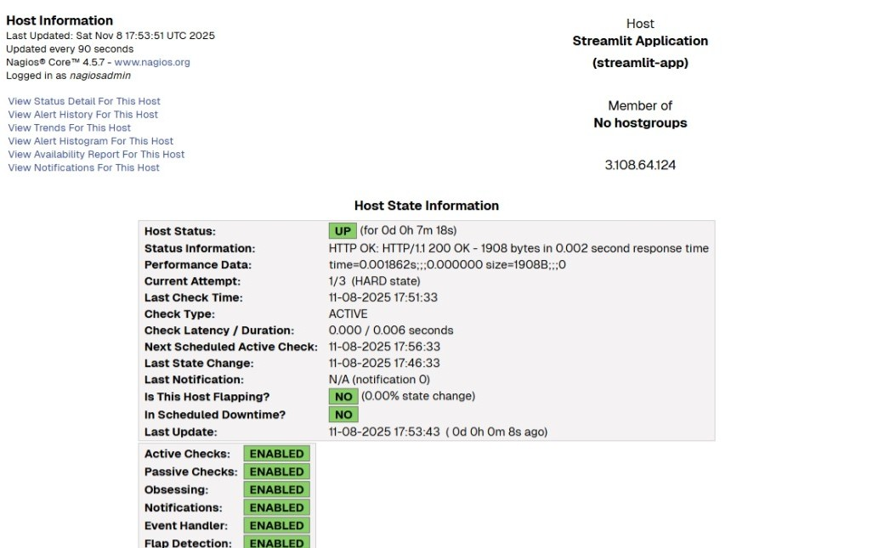

Slide 29
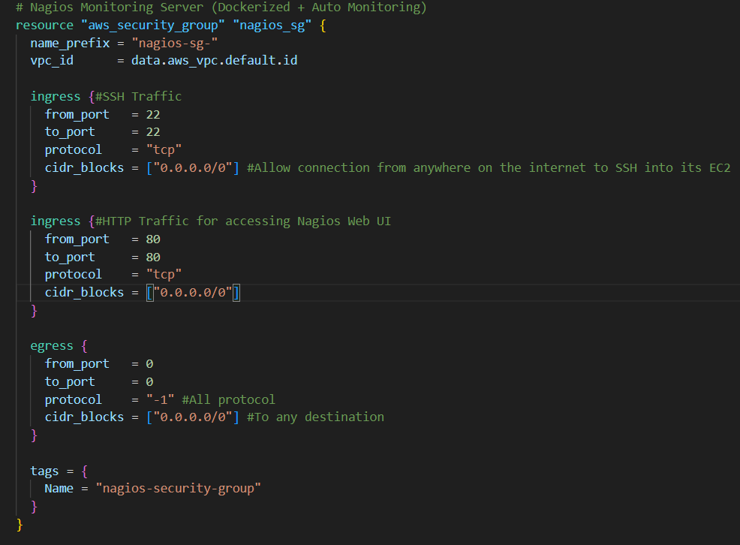
Security Groups

Slide 30
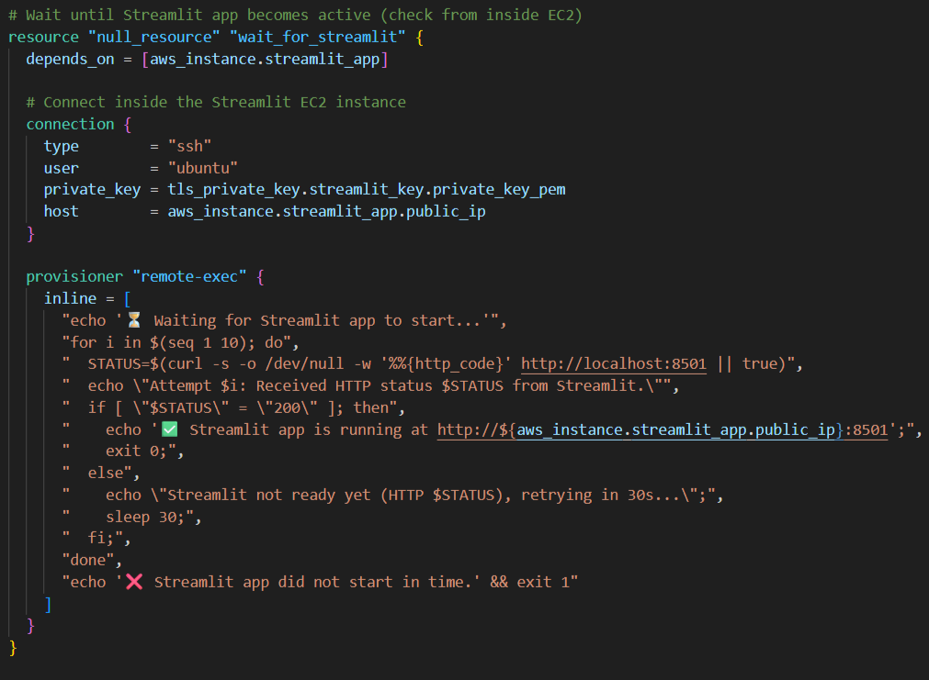
Wait for Streamlit

Slide 31
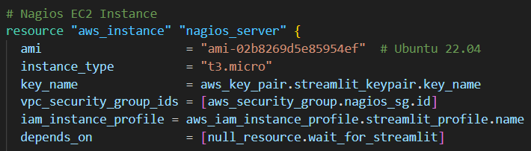
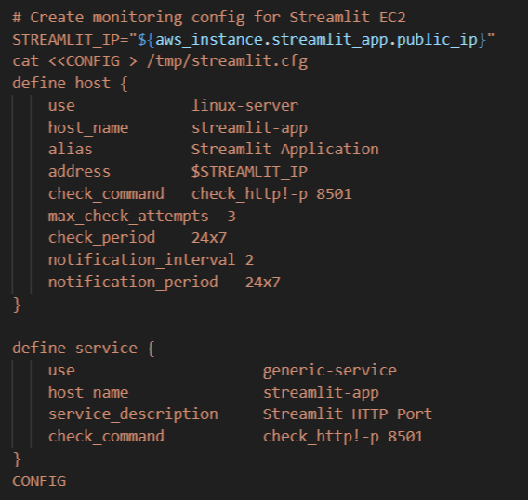
Nagios_EC2_Instance
Nagios Monitoring Configuration

Slide 32
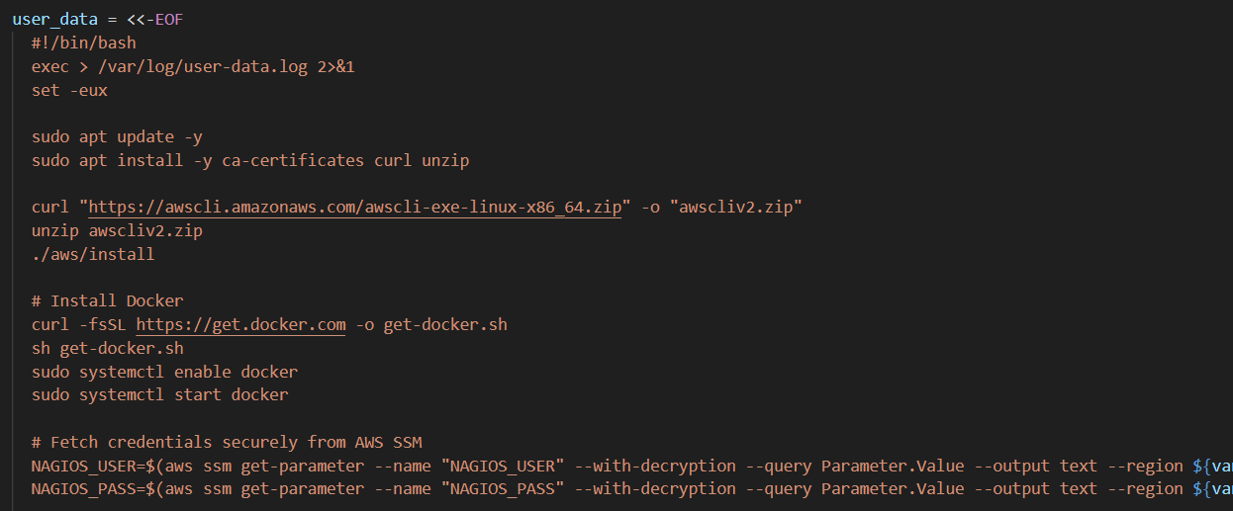
Aws Cli, docker and Nagios setup

Slide 33
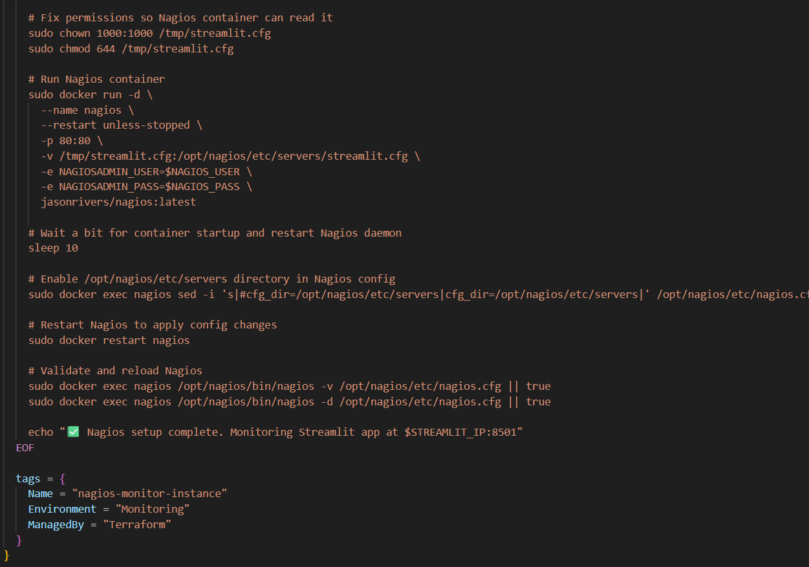
1) Run Nagios container on port 80
2) Binds cfg file into servers folder
3) Adds a delay to let Nagios inside the container come up before modifying config.
4) Uncomment the servers directory. By default jasonrivers/nagios container comments them all so Nagios doesn’t waste time scanning.
5) Restart Nagios to apply changes
6) Run Validation daemonization but don’t abort the script if they fail.

